Slide 1

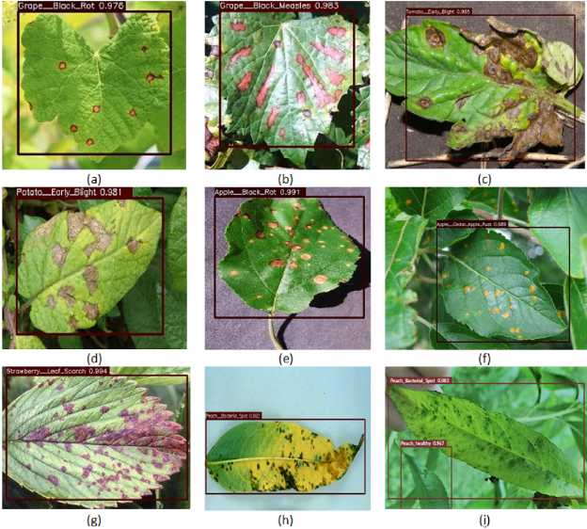
A deep learning based approach for automated plant disease classification using vision transformer

Slide 2
Background
Plant diseases are a major cause of crop loss and can have significant economic and environmental impacts.
Early detection and accurate classification of plant diseases can help prevent disease spread and improve crop yield
Deep learning techniques, such as convolutional neural networks (CNNs), have shown promising results for plant disease detection and classification

Slide 3
Objective
The objective of this study was to develop a deep learning-based system for detecting and classifying plant diseases using CNNs
The authors aimed to compare the performance of different CNN architectures and training strategies for plant disease classification

Slide 4

Dataset
The authors used the PlantVillage dataset, which includes over 54,000 images of healthy and diseased plant leaves from 14 crop species
The dataset was split into training, validation, and test sets, with a ratio of 70:15:15

Slide 5
Methodology
The authors trained and evaluated three different CNN architectures: VGG-16, InceptionV3, and ResNet-50
They used transfer learning to adapt the pre-trained CNNs to the plant disease classification task
The models were trained using different data augmentation techniques and hyperparameters to optimize performance

Slide 6
Results
The authors found that all three CNN architectures achieved high accuracy (> 95%) for plant disease classification
The VGG-16 model achieved the highest accuracy of 98.2% on the test set
Data augmentation techniques, such as rotation and flipping, improved the models' performance
The authors also found that fine-tuning the CNNs' lower layers improved performance compared to freezing all pre-trained layers

Slide 7
Conclusion
The authors demonstrated that deep learning-based systems using CNNs can achieve high accuracy for plant disease detection and classification
Transfer learning and data augmentation techniques can improve the models' performance
The authors suggest that their approach could be applied to other plant disease datasets and could help improve crop yield and food security

Slide 8

Future work
The authors suggest that future work could explore the use of other deep learning techniques, such as attention mechanisms or graph neural networks, for plant disease classification
They also suggest that more research is needed on the generalizability of deep learning models to different plant species and environments
Finally, the authors suggest that their approach could be integrated into a smartphone app or other portable device for real-time plant disease detection and diagnosis

Slide 9
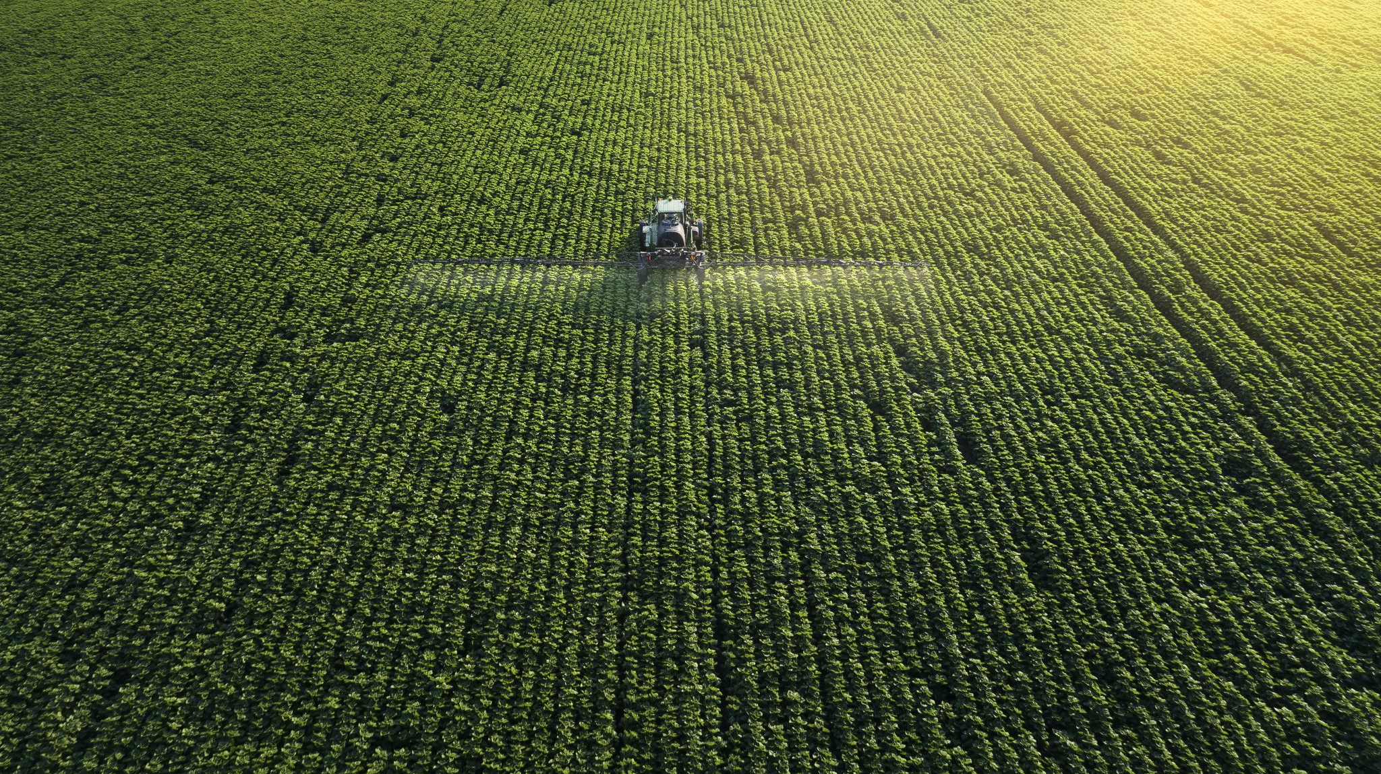
References
Safari, B., Alborzi, Y. & Najafi, E. Automated wheat disease detection using a ROS-based autonomous guided UAV. arXiv preprint arXiv:2206.15042 (2022).
Simonyan, K. & Zisserman, A. Very deep convolutional networks for large-scale image recognition. arXiv preprint arXiv:1409.1556 (2014).
He, K., Zhang, X., Ren, S. & Sun, J. Deep residual learning for image recognition. in Proceedings of the IEEE Conference on Computer Vision and Pattern Recognition. 770–778. (2016).
Szegedy, C., Vanhoucke, V., Ioffe, S., Shlens, J. & Wojna, Z. Rethinking the inception architecture for computer vision. In Proceedings of the IEEE Conference on Computer Vision and Pattern Recognition. 2818–2826. (2016).
And other references you will found on A deep learning based approach for automated plant disease classification using vision transformer | Scientific Reports (nature.com)

Slide 10

Thank you

